Slide 1
OOSE UNIT-2

Slide 2
Chapter-1
Software Requirements

Slide 3
Requirement is defined as
A condition or capability needed by a user to solve a problem or achieve an objective.
Software requirements for a system are the description of
what the system should do

Slide 4
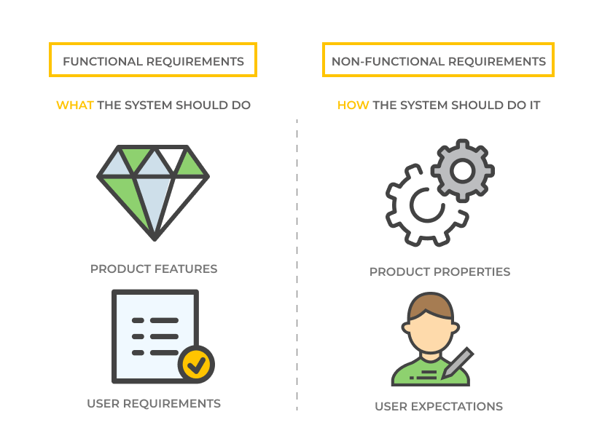
Two categories of requirements
Requirements can be majorly divided into only two categories
– Functional And Non-functional Requirements.

Slide 5
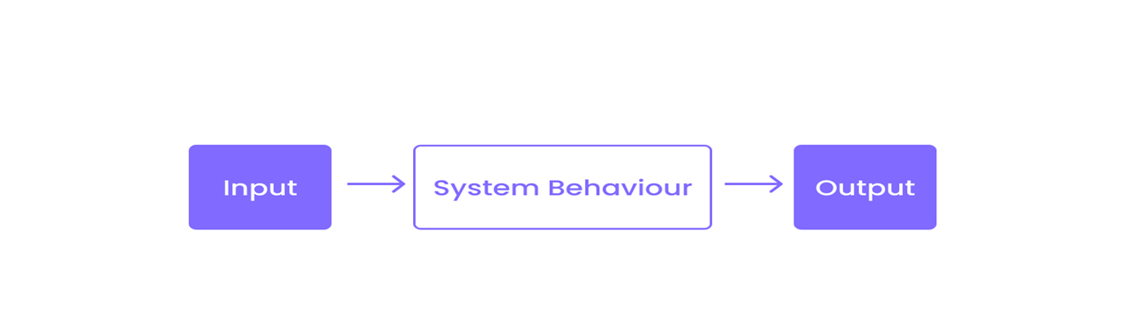
What are Functional Requirements?
A functional requirement is what the entire system or its individual components should be.
It covers all the functions that the software must perform.
In turn, the term "function" means the inputs needed for a system to properly perform, the outputs it produces, and its behavior.
This includes all the functionality describing what the system is supposed to do.

Slide 6
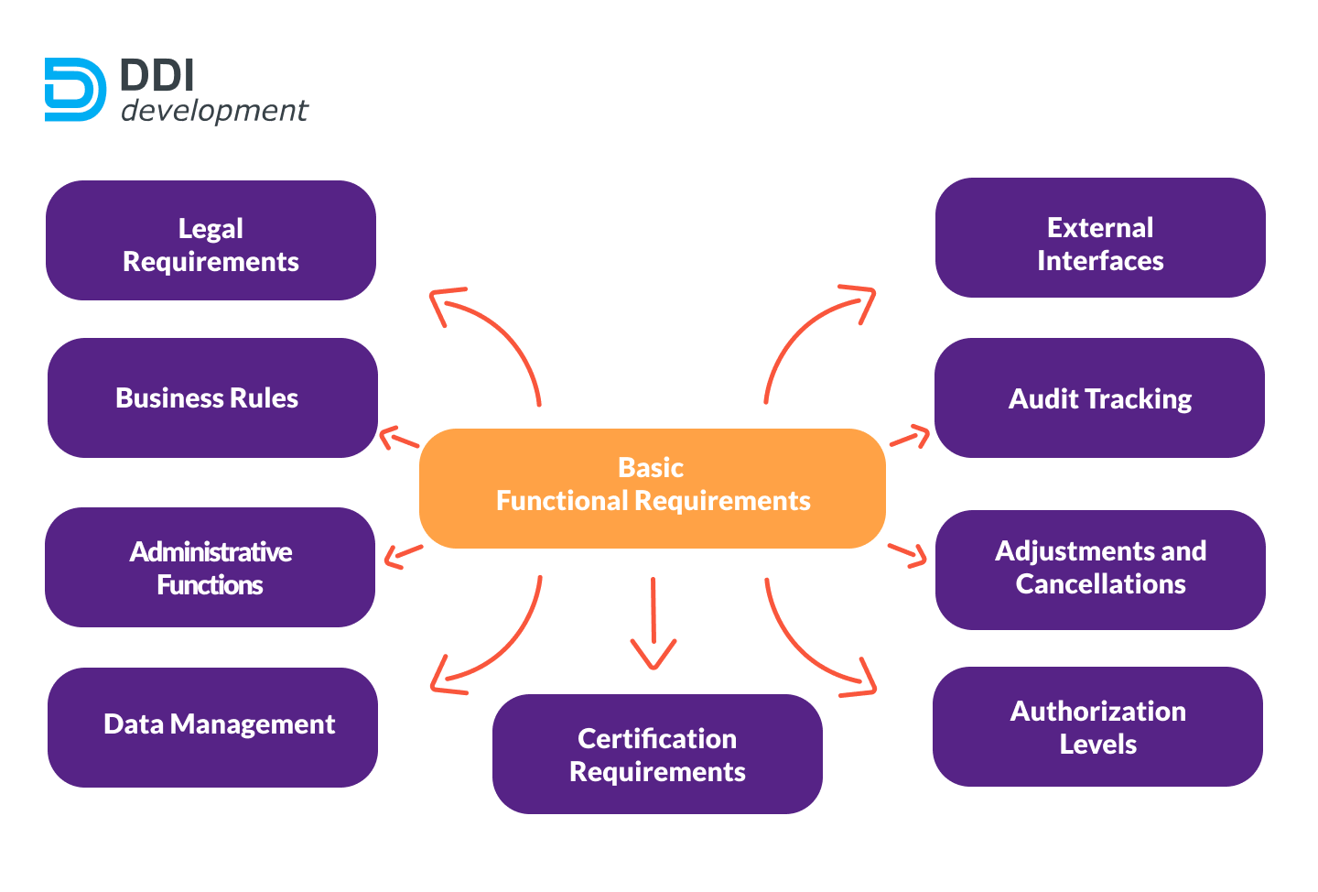

Slide 7
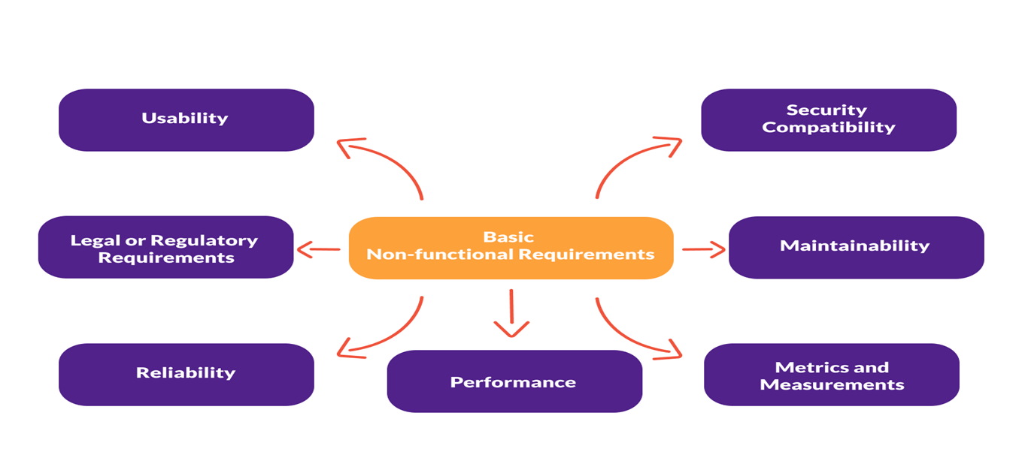
What are Non-functional Requirements?
They define the attributes of software quality. This includes a set of standards against which the quality of a particular system is judged.

Slide 9
Non-functional requirements :
Product requirements
Requirements which specify that the delivered product must behave in a particular way
e.g. execution speed, reliability, etc.
Eg:The user interface for LIBSYS shall be implemented as simple HTML without
frames or Java applets.
Organisational requirements
Requirements which are a consequence of organizational policies and procedures
e.g. process standards used, implementation requirements, etc.
Eg: The system development process and deliverable documents shall conform to
the process and deliverables defined in XYZCo-SP-STAN-95.
External requirements
Requirements which arise from factors which are external to the system and its
development process
e.g. interoperability requirements, legislative requirements, etc.
Eg: The system shall not disclose any personal information about customers apart
from their name and reference number to the operators of the system.

Slide 10
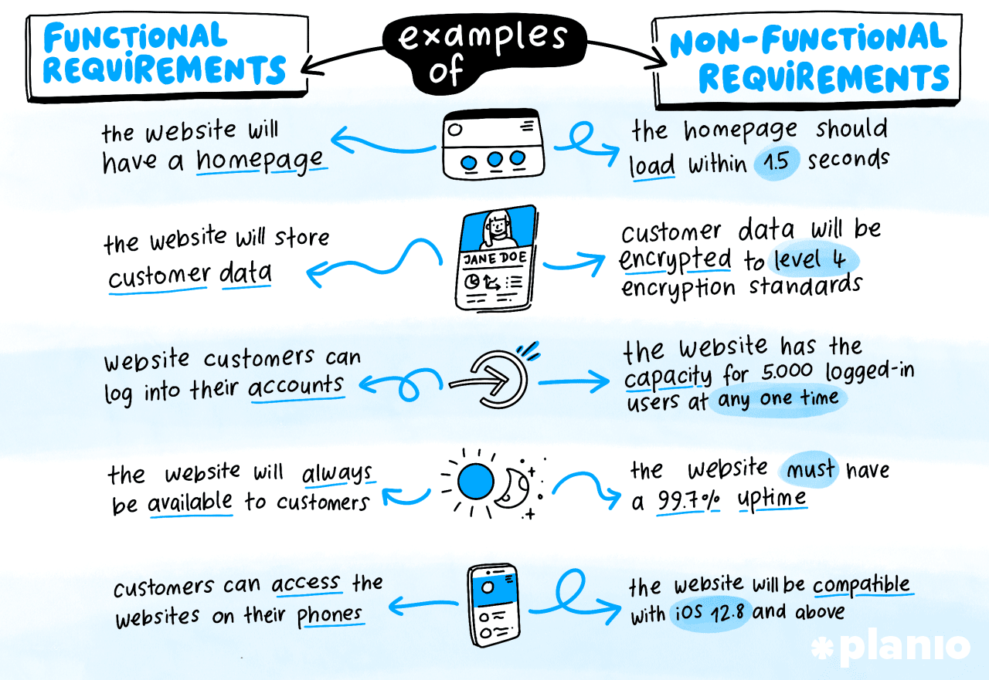

Slide 11
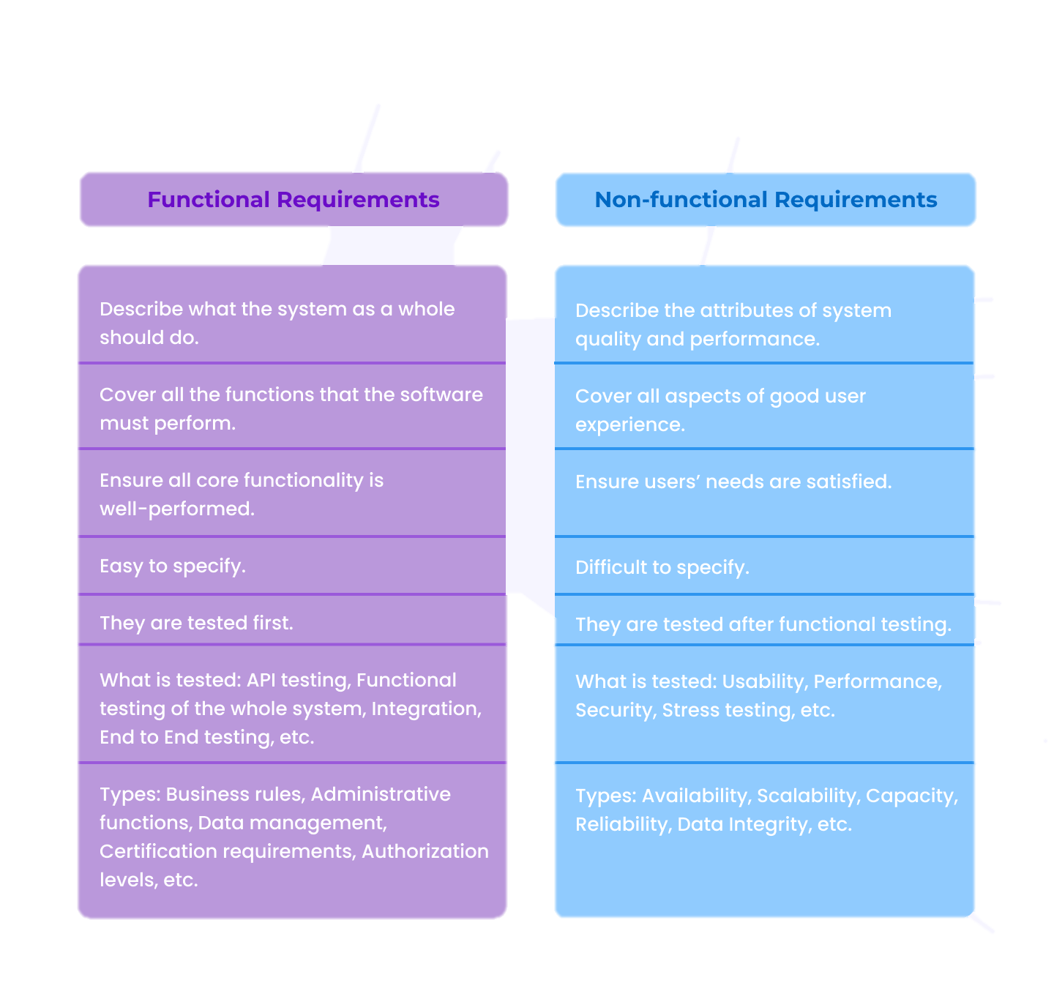
Difference between Functional and Non-functional Requirements

Slide 12
User
and
System Requirements

Slide 13
User requirements and system requirements may be defined as follows:
User requirements
natural language statements, tables, diagrams written for customers
specifies what system services to provide for system users
the constraints under which it must operate.
Specifies precise descriptions of the system functionality.
System requirements
are more detailed descriptions of the software system’s functions, services, and operational constraints.
The system requirements document should define exactly what is to be implemented.
It may be part of the contract between the system buyer and the software developers.

Slide 14
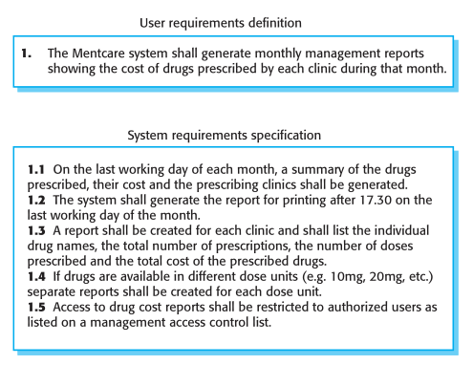
Figure illustrates the distinction between user and system requirements. This example from the mental health care patient information system (Mentcare) shows how a user requirement may be expanded into several system requirements. You can see from Figure that the user requirement is quite general. The system requirements provide more specific information about the services and functions of the system that is to be implemented.

Slide 15
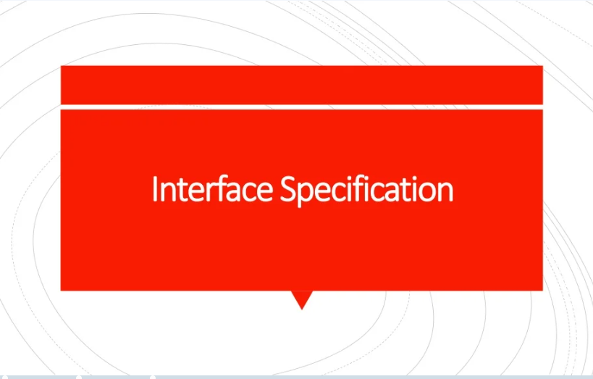

Slide 16
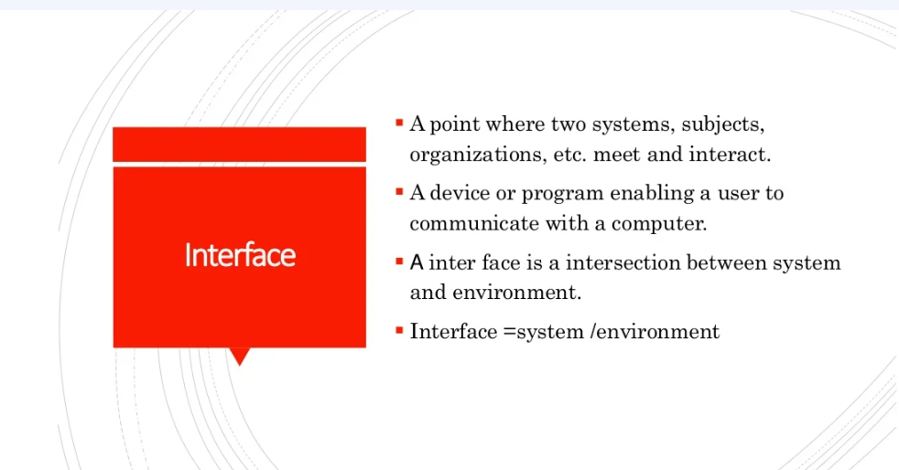

Slide 17
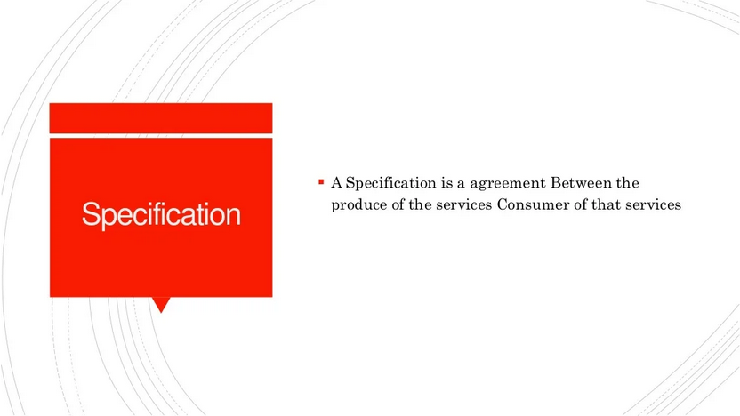

Slide 18
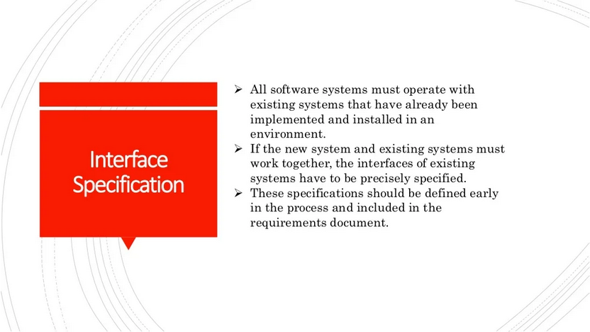
Most systems must operate with other systems and the operating interfaces must be specified as part of the requirements
Three types of interface may have to be defined
Procedural interfaces(APIs)
Data structures that are exchanged(DFDs)
Data representations(bits and bytes)
Formal notations are an effective technique for interface specification

Slide 19
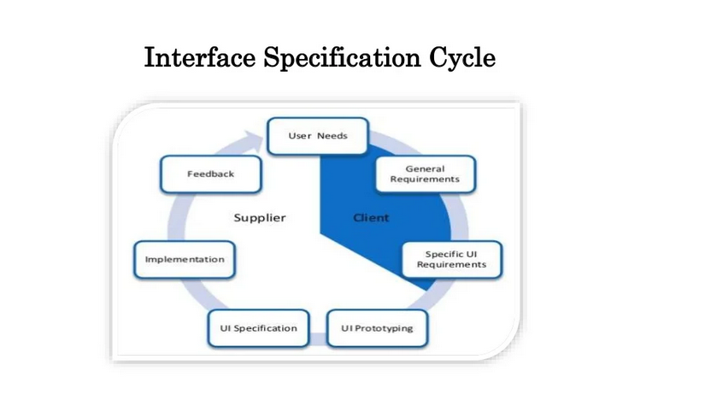

Slide 20
What Is a Software Requirements Specification (SRS) Document?
A software requirements specification (SRS) is a document that describes what the software will do and how it will be expected to perform.
It also describes the functionality the product needs to fulfill all stakeholders (business, users) needs.
An SRS can be simply summarized into four Ds:
Define your product's purpose.
Describe what you're building.
Detail the requirements.
Deliver it for approval.

Slide 21
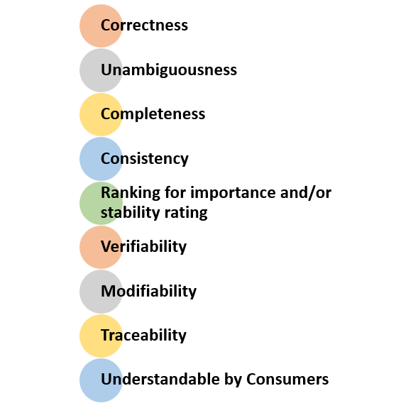
Qualities of a good SRS Document

Slide 22
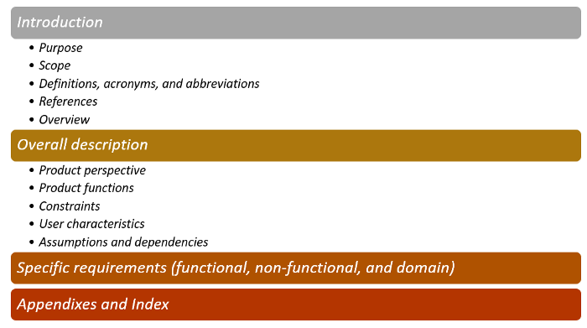
How is an SRS document prepared?
The first step in the development of an SRS document is to use an existing template or to compose a more personalized outline.
An SRS document must contain the following sections, and its information must be organized in the following order as shown in the image below according to IEEE standards:

Slide 24
Steps of Requirements Engineering
Requirements elicitation & Analysis
Discovery & Prototyping
Problem statement
Requirements specification
Description & Organizing
Requirements engineering
Requirements validation
V&V procedures
Requirements Management
Changes and management
SRS
Requirements Documentation
written text or illustration

Slide 25
The requirements engineering process
F
easibility
R
equir
ements
stud
y
elicitation and
anal
ysis
R
equir
ements
specification
F
R
equir
ements
easibility
r
epor
t
validation
S
ystem
models
User and system
requirements
R
equir
ements
document

Slide 26
Feasibility studies
A feasibility study decides whether or not the proposed system is worthwhile.
A short focused study that checks
If the system contributes to organisational objectives;
If the system can be engineered using current technology and within budget;
If the system can be integrated with other systems that are used.

Slide 27
Elicitation and analysis
Sometimes called requirements elicitation or requirements discovery.
A people-intensive process.
Involves technical staff working with customers to find out about the application domain, the services that the system should provide and the system’s operational constraints.
May involve end-users, managers, engineers involved in maintenance, domain experts, trade unions, etc. These are called stakeholders.

Slide 28
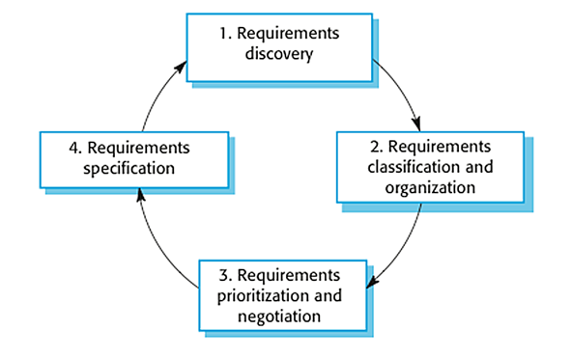
The requirements elicitation processes

Slide 29
Process activities
Requirements discovery
Interacting with stakeholders to discover their requirements. Domain requirements are also discovered at this stage.
Requirements classification and organisation
Groups related requirements and organises them into coherent clusters.
Prioritisation and negotiation
Prioritising requirements and resolving requirements conflicts.
Requirements documentation
Requirements are documented and input into the next round of the spiral.

Slide 30
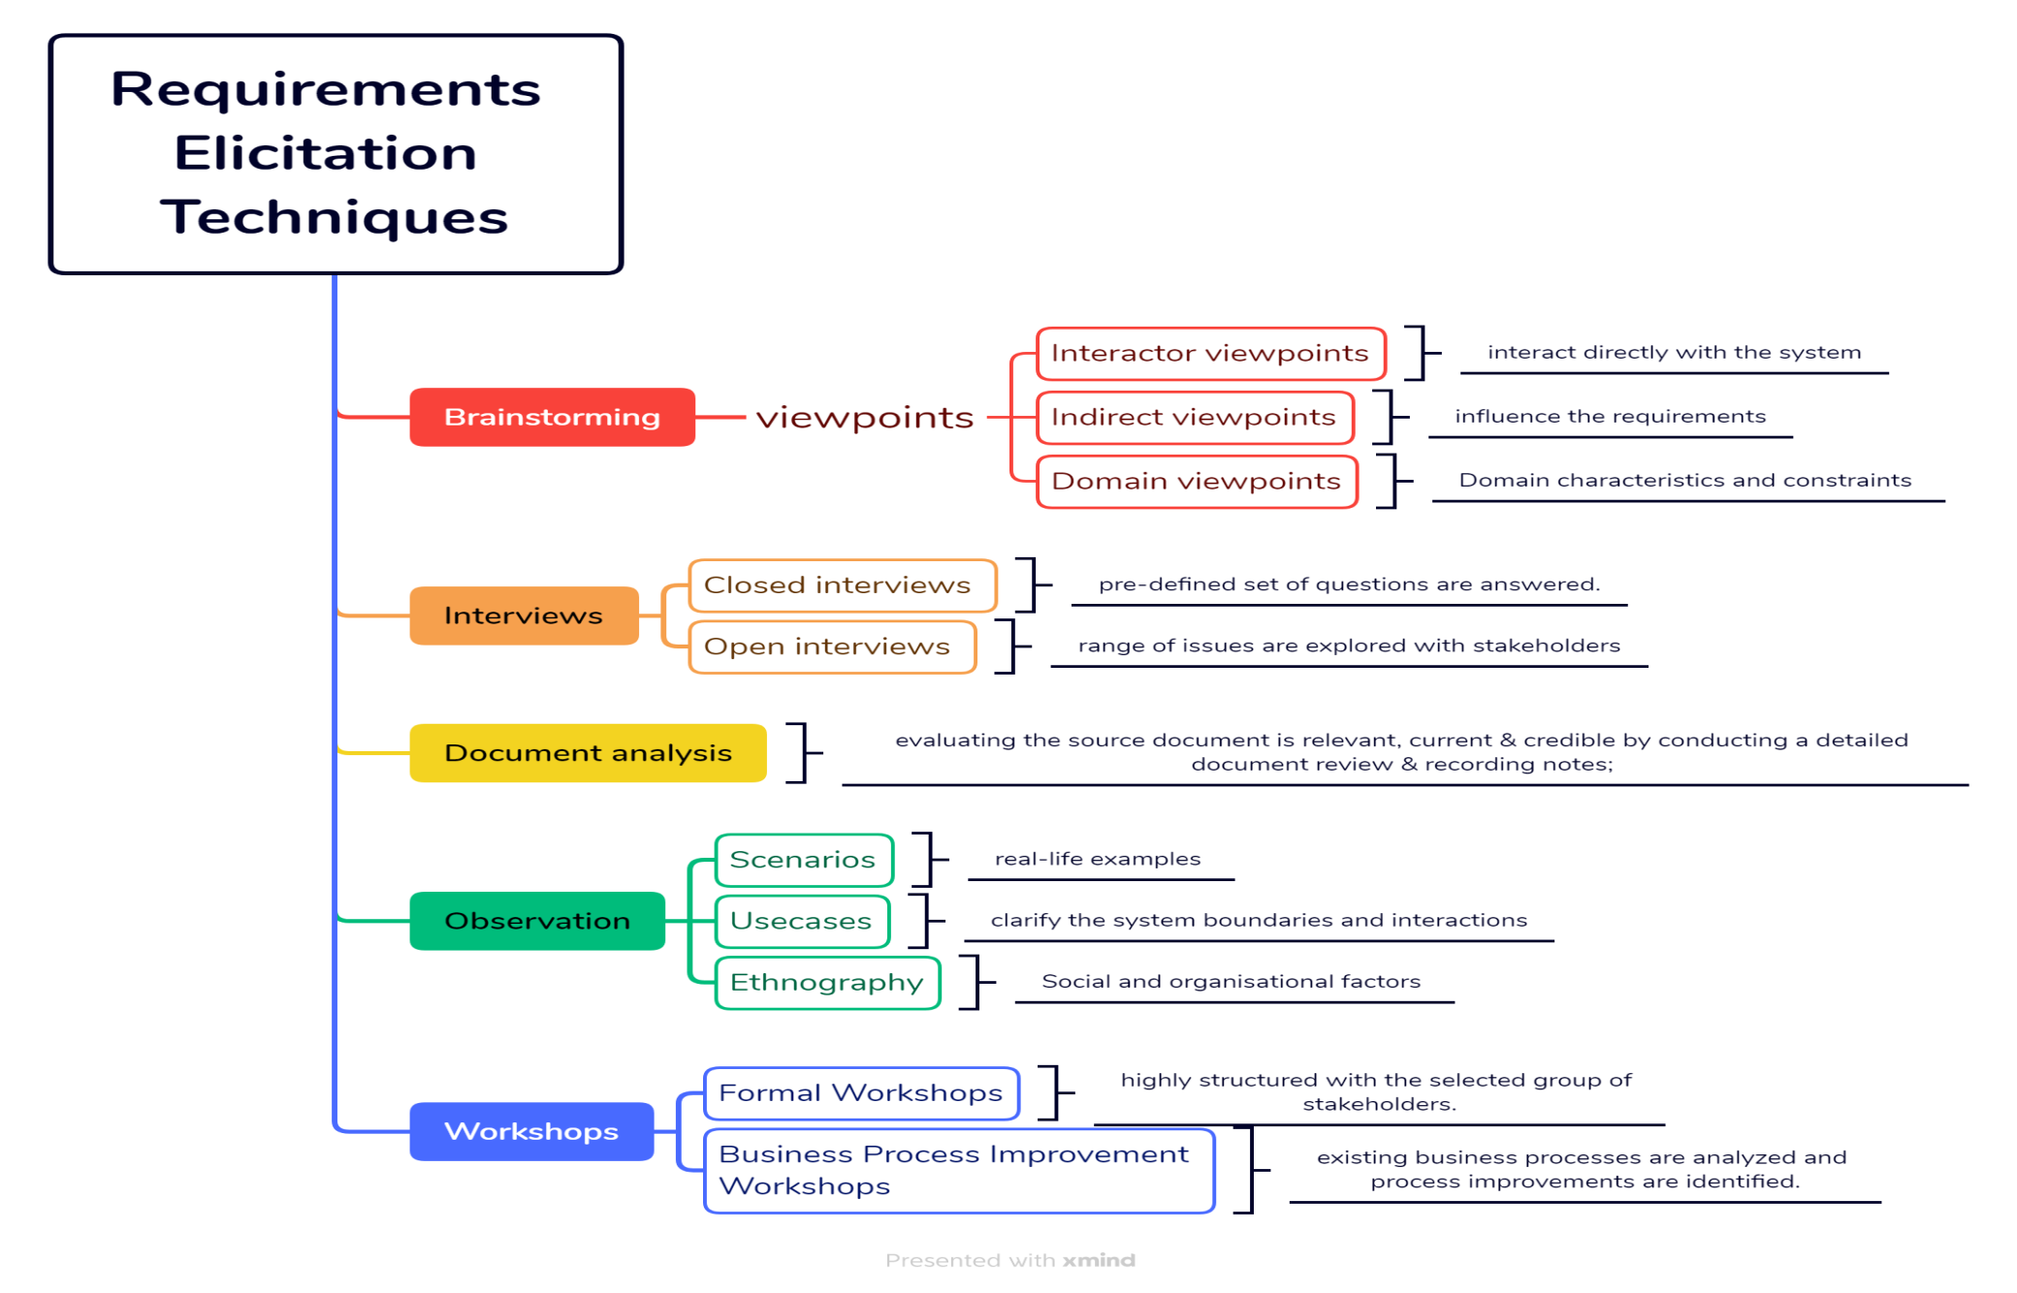

Slide 31
Requirements validation
Concerned with demonstrating that the requirements define the system that the customer really wants.
Requirements error costs are high so validation is very important
Fixing a requirements error after delivery may cost up to 100 times the cost of fixing an implementation error.

Slide 32
Requirements checking
Validity. Does the system provide the functions which best support the customer’s needs?
Consistency. Are there any requirements conflicts?
Completeness. Are all functions required by the customer included?
Realism. Can the requirements be implemented given available budget and technology
Verifiability. Can the requirements be checked?

Slide 34
Requirements validation techniques
Requirements reviews
Systematic manual analysis of the requirements.
Prototyping
Using an executable model of the system to check requirements.
Test-case generation
Developing tests for requirements to check testability.

Slide 35
Requirements management
Requirements management is the process of managing changing requirements during the requirements engineering process and system development.
Requirements are inevitably incomplete and inconsistent
New requirements emerge during the process as business needs change and a better understanding of the system is developed;
Different viewpoints have different requirements and these are often contradictory.

Slide 36
Requirements evolution
Initial
Changed
understanding
understanding
of
pr
ob
lem
of
pr
ob
lem
Initial
Changed
r
equir
ements
r
equir
ements
T
ime

Slide 37
Enduring and volatile requirements
Enduring requirements. Stable requirements derived from the core activity of the customer organisation. E.g. a hospital will always have doctors, nurses, etc. May be derived from domain models
Volatile requirements. Requirements which change during development or when the system is in use. In a hospital, requirements derived from health-care policy

Slide 38
Volatile requirements

Slide 39
Requirements management planning
During the requirements engineering process, you have to plan:
Requirements identification
How requirements are individually identified;
A change management process
The process followed when analysing a requirements change;
Traceability policies
The amount of information about requirements relationships that is maintained;
CASE tool support
The tool support required to help manage requirements change;

Slide 40
Traceability
Traceability is concerned with the relationships between requirements, their sources and the system design
Source traceability
Links from requirements to stakeholders who proposed these requirements;
Requirements traceability
Links between dependent requirements;
Design traceability
Links from the requirements to the design;

Slide 41
A traceability matrix

Slide 42
CASE tool support
Requirements storage
Requirements should be managed in a secure, managed data store.
Change management
The process of change management is a workflow process whose stages can be defined and information flow between these stages partially automated.
Traceability management
Automated maintenance and retrieval of the links between requirements.

Slide 43
Requirements change management
Should apply to all proposed changes to the requirements.
Principal stages
Problem analysis. Discuss requirements problem and propose change;
Change analysis and costing. Assess effects of change on other requirements;
Change implementation. Modify requirements document and other documents to reflect change.

Slide 44
Change management

Slide 45


